Slide 1

Department of Computer Science and Engineering
An Interactive PDF Chatbot Using Semantic Embeddings and FAISS-Based Vector Search
PRESENTED BY
DUDDU SATISH BABU
22471A05M0
KOPPURAVURI V S N S S ASHOK KUMAR
22741A05M8
RAJABOINA CHANDRASEKHAR
21471A05Q2
Under the Guidance of,
SYED RIZWANA
_{M.Tech ,(P.HD)}
Assistant Professor,
Department of Computer Science and Engineering,
Narasaraopeta Engineering College (Autonomous),
Narasaraopet- 522 601.

Slide 2
OUTLINE
1. Abstract
2. Introduction
3. Literature Survey
4. Research Gaps
5. Problem Statement
6. Objectives
7. Block Diagram / Flow Diagram
8. Methodology
9. Implementation
10. Results and Analysis
11. Conclusion & Future Scope
12. References
13. Question and Answers
14. Acknowledgements

Slide 3
ABSTRACT
Abstract of the project
Rapid growth of digital PDFs demands intelligent, semantic retrieval.
Keyword search fails to capture contextual meaning.
Proposed chatbot enables natural-language queries on uploaded PDFs.
Combines Sentence-BERT embeddings, FAISS similarity search, and FLAN-T5-XL for generative answers.
Outperforms keyword-based systems in accuracy and contextual relevance.
Implemented as a web application for easy interaction.

Slide 4
Saves time for researchers and professionals.
INTRODUCTION
Brief introduction to the project
PDFs are widely used but hard to search effectively.
Keyword search gives incomplete or irrelevant results.
Proposed chatbot enables natural-language querying of PDFs using AI.
Motivation behind the project
Make document search simple and intelligent.
Overcome limits of keyword-based systems.
Use NLP and LLMs for smarter, context-aware retrieval.
Importance and relevance
Saves time for researchers and professionals.
Provides accurate, conversational answers from PDFs.
Supports next-gen human–computer interaction.

Slide 5
LITERATURE SURVEY
No | Title | Author | Journal Name & Year | Methodology Adapted | Key Findings | Gaps
1 | Co-Pilot for Project Managers: Developing a PDF-Driven AI Chatbot for Facilitating Project Management | Khorshed Alam, Mahbubul Haq Bhuiyan, Mohammad Shafiqul Islam, Abul Hossain Chowdhury, Zaheed Ahmed Bhuiyan, and Suman Ahmmed, 2025, IEEE Access | https://ieeexplore.ieee.org/document/10912498 | OpenAssistant SFT-1 12B (fine-tuned on Pythia 12B architecture) Cosine similarity scoring Semantic similarity scoring | First chatbot acting as a virtual project manager specifically for project management automation context-aware project guidance from PDF documents (e.g., SRS reports) | Currently focused only on e-commerce project management No integration yet of image-based data (e.g., diagrams, visuals)
2 | An LLM-Driven Chatbot in Higher Education for Databases and Information Systems | Alexander T. Neumann et al., 2025, IEEE Transactions on Education | https://ieeexplore.ieee.org/document/10706931 | RAG + LLM-based GPT model | Students found the chatbot useful and easy to use Enhanced self-regulated learning (SRL) and reduced help-seeking anxiety | LLM hallucination issues No long-term or cross-course evaluation Cost and scalability challenges remain
3 | Data Augmentation and Preparation Process of PerInfEx: A Persian Chatbot With the Ability of Information Extraction | Pegah Safari & Mehrnoush Shamsfard, 2024, IEEE Access | https://ieeexplore.ieee.org/document/10418595 | GPT-3.5, Conditional BERT, Active Learning | First Persian open-domain chatbot corpus | Niche focus on personal info extraction No real-time chatbot deployment or evaluation
4 | A Hybrid Chatbot Model for Enhancing Administrative Support in Education | Kanaan Mikael et al., 2025, IEEE Access | https://ieeexplore.ieee.org/document/10930906 | Multinomial Naive Bayes classifier, rule-based logic, generative modules | Flexible routing of user queries Reduced admin workload and scalable to other domains | Only tested at Sakarya University No external evaluation or general dataset comparison
5 | Using the SOCIO Chatbot for UML Modelling: A Family of Experiments | Ranci Ren et al., 2023, IEEE Transactions on Software Engineering | https://ieeexplore.ieee.org/document/9712254 | None; evaluation based on usability metrics and statistical modeling | SOCIO users were faster and more satisfied Chatbotgenerated diagrams wereconcise and effective for modelling | Focus limited to class diagrams Participants were all students

Slide 6
Literature Deep-Dive – LLMs in Education (Neumann et al., 2025)
Proposed an LLM-powered educational chatbot to assist students in database learning.
Used Retrieval-Augmented Generation (RAG) to combine information retrieval with generative responses.
Integrated GPT-based language models for natural and conversational interaction.
Demonstrated that chatbots can reduce help-seeking anxiety among students.
Improved student engagement and self-paced learning through interactive querying.
Highlighted the importance of context-aware retrieval for accurate educational assistance.
Motivated the interactive, user-friendly design of our PDF chatbot system.

Slide 7
Literature Deep-Dive – Project Management Automation (Alam et al., 2025)
Developed a PDF-driven AI chatbot for project document management.
Employed OpenAssistant SFT-1 12B as the core large language model.
Used cosine similarity for semantic document retrieval.
Focused on automating project planning and document querying tasks
Evaluated system performance using retrieval accuracy and response latency.
Identified scalability and efficiency challenges in large document processing.
Served as the primary baseline model for comparison with our proposed system.

Slide 8
The Challenge of “Dark Data” in PDFs
PDFs preserve layout but not machine understanding, making automatic information extraction difficult..
Static document nature creates “dark data”, where valuable information exists but remains inaccessible to intelligent systems..
Modern PDFs are long and complex, containing dense and multi-sectioned content..
Manual searching is time-consuming, requiring users to scan multiple pages to find relevant information.
Keyword-based search relies on exact word matching, failing to capture meaning or intent..
Semantic relationships and synonyms are ignored, leading to incomplete or irrelevant results..
Non-expert users struggle with information retrieval, as current tools cannot understand paraphrased or natural language queries.

Slide 9

Why Semantic Search?
Goes beyond keyword matching by understanding the intent and contextual meaning of user queries.
Retrieves relevant results even with different wording, handling synonyms and paraphrased queries effectively.
Provides context-aware understanding, enabling natural and human-like interaction with documents.
Uses dense vector embeddings generated by transformer models such as BERT and Sentence-BERT.
Preserves hidden semantic meaning, capturing relationships between words and sentences beyond surface text.
Represents text in a geometric semantic space, where similar meanings are located closer together.
Improves retrieval accuracy and relevance, leading to higher precision and better user satisfaction compared to keyword-based search.

Slide 10
Most studies focus on domain-specific chatbots (education, management, SMEs) rather than general-purpose PDF interaction systems.
Limited work on semantic understanding and vector-based retrieval for unstructured document data.
Few integrations of retrieval and generative models in a unified, end-to-end framework.
Existing systems lack multimodal capabilities (cannot process diagrams, images, or scanned PDFs).
Evaluation often limited to surveys or user perception, not robust technical performance metrics.
Scalability and real-time response optimization remain unresolved in large document processing.
Minimal research on reducing hallucination and improving factual accuracy in LLM-based chatbots.
RESEARCH GAPS

Slide 11
PROBLEM STATEMENT
Problem Definition
Extracting accurate information from long, unstructured PDF documents is difficult.
Keyword-based searches fail to capture semantic meaning and context.
Users need an intelligent system that understands natural language and retrieves relevant content efficiently.
Significance
Enables faster and more precise access to information in PDFs.
Reduces manual effort in document reading and searching.
Improves productivity for researchers, educators, and professionals.

Slide 12
OBJECTIVES
To develop an interactive chatbot capable of answering queries from PDF documents.
To apply Sentence-BERT embeddings and FAISS indexing for semantic text retrieval.
To generate context-aware, natural language responses using the FLAN-T5 model.
To evaluate the system’s accuracy, speed, and usability against traditional search methods.

Slide 13
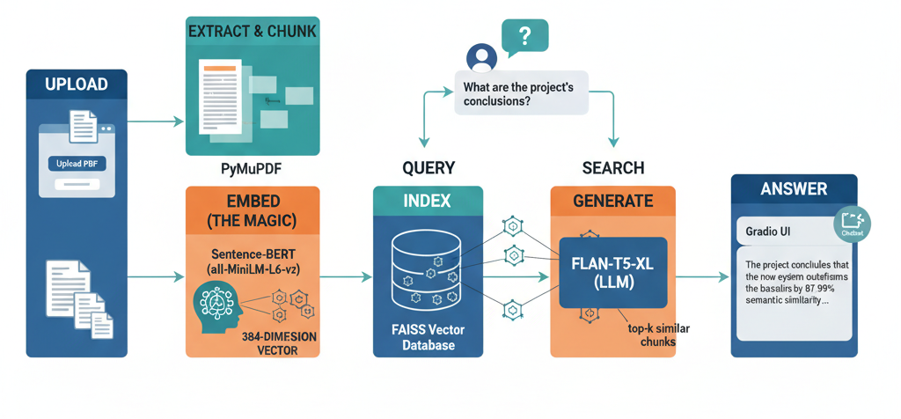
BLOCK DIAGRAM OR FLOW DIAGRAM

Slide 14
METHODOLOGY
An interactive PDF chatbot framework is developed for semantic question answering.
Integrates three key models — Sentence-BERT, FAISS, and FLAN-T5-XL — for embedding, retrieval, and response generation.
Text extracted from uploaded PDF documents using the PyMuPDF library.
Each document is converted into structured text and segmented into overlapping context chunks for better continuity.
Lowercasing, punctuation and stop-word removal, lemmatization, and numeric normalization.
Tokenization performed to prepare input for the transformer encoder.
Ensures consistency and improves accuracy during embedding and retrieval.
Each model is fine-tuned using the Hugging Face Transformers library, ensuring efficient GPU-based execution in Google Colab.
Evaluation Metrics: Cosine Similarity and Semantic Similarity Score used to assess retrieval accuracy.

Slide 15
Frameworks, Algorithms, and Tools:
Frameworks Used: Hugging Face Transformers, PyTorch, and Gradio for model integration and interface,Google Colab (NVIDIA Tesla T4 GPU).
Algorithms Implemented:
Sentence-BERT (all-MiniLM-L6-v2): Generates 384-dimensional semantic embeddings for document chunks and user queries..
FAISS Similarity Search: Performs approximate nearest-neighbor (ANN) retrieval based on cosine similarity..
FLAN-T5-XL: Instruction-tuned transformer that generates context-aware answers using retrieved text segments.
Processing Strategy:
Text Chunking: 50% overlap to preserve semantic continuity across segments.
Vector Normalization: L2 normalization applied before FAISS indexing.

Slide 16
IMPLEMENTATION
The project was implemented using Python and Hugging Face Transformers within Google Colab, enabling GPU acceleration and efficient fine-tuning of summarization models.
PDF Text Extraction: Using PyMuPDF to retrieve structured text.
Chunking: Dividing text into 50% overlapping segments for context preservation.
Embedding Generation: Sentence-BERT (all-MiniLM-L6-v2) used to create dense vectors
Indexing & Retrieval: FAISS library for top-k semantic matching.
Answer Generation: FLAN-T5-XL produces context-aware natural language responses.
Interface: Built with Gradio for interactive user input and output.

Slide 17
Document Ingestion & Extraction
The system begins by ingesting user-uploaded PDF documents for processing.
PyMuPDF (fitz) library is used for robust and reliable PDF text extraction.
The extraction process iterates through each page of the PDF sequentially.
Only visible and readable text is extracted, avoiding metadata noise.
Extracted text from all pages is concatenated into a unified string..
This approach ensures no content loss during conversion from PDF layout to raw text.
Standardized text output serves as the foundation for downstream semantic processing.

Slide 18
Intelligent Text Chunking
Chunking significantly improves retrieval accuracy and answer relevance.
Large extracted text is not processed as a single block to avoid context dilution.
A sliding window chunking technique is employed for segmentation.
Text is divided into manageable chunks suitable for transformer models.
A 50% overlap between adjacent chunks is maintained.
Overlapping preserves semantic continuity at chunk boundaries.
Prevents the model from losing contextual flow between segments.

Slide 19
Semantic Text Preprocessing
Preprocessing ensures uniform and clean text representation.
All text is converted to lowercase to eliminate case-based inconsistencies.
Extra whitespaces are removed to maintain formatting consistency.
Punctuation and stop-words are stripped to reduce noise.
Focus is placed on meaningful and content-bearing tokens.
Standalone digits are replaced with placeholders such as “NUM”.
Normalization improves semantic similarity and embedding quality.

Slide 20
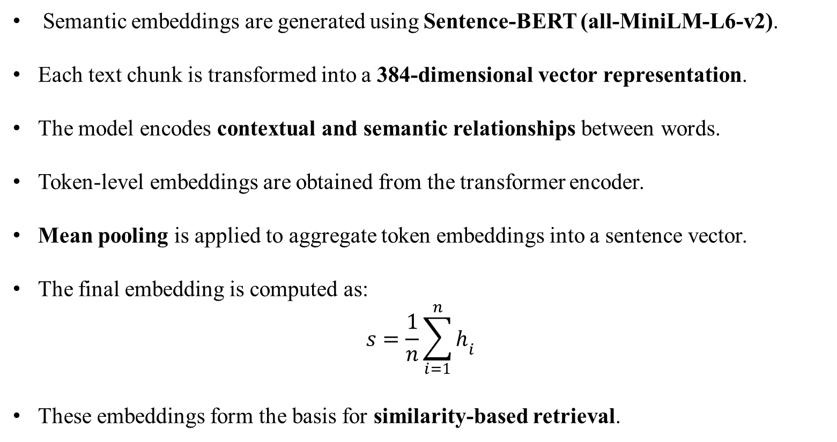
The Mathematics of Embedding
Semantic embeddings are generated using Sentence-BERT (all-MiniLM-L6-v2).
Each text chunk is transformed into a 384-dimensional vector representation.
The model encodes contextual and semantic relationships between words.
Token-level embeddings are obtained from the transformer encoder.
Mean pooling is applied to aggregate token embeddings into a sentence vector.
The final embedding is computed as:
$$s=\frac{1}{n}\sum_{i=1}^{n}{h_{i}}$$
These embeddings form the basis for similarity-based retrieval.

Slide 21
Efficient Retrieval with FAISS
FAISS (Facebook AI Similarity Search) is used for large-scale vector retrieval.
It is optimized for high-dimensional and dense embedding spaces.
FAISS performs Approximate Nearest Neighbor (ANN) search.
Enables fast retrieval even for large document collections.
Retrieval is based on inner product similarity.
Cosine similarity measures semantic closeness between query and chunks.
The top-k most relevant chunks are selected as context for answer generation.

Slide 22
Generative Answer Construction
Answer generation is performed using the FLAN-T5-XL language model.
FLAN-T5-XL is an instruction-tuned transformer model.
The user query is combined with top-k retrieved chunks.
This combined input forms a single structured prompt.
Prompt engineering ensures context-aware answer generation.
The model predicts the most probable word sequence using conditional probability.
Generates fluent, coherent, and contextually grounded responses.

Slide 23
Software Specifications:
Operating System: Windows 10 / Google Colab Environment
Programming Language: Python 3.10
Libraries & Frameworks: Transformers, PyTorch, NLTK, NumPy, Pandas, Matplotlib
Development Tools: Google Colab, Jupyter Notebook, GitHub
Evaluation Metrics: Cosine Similarity, Semantic Similarity Score, Top-k Retrieval Accuracy
Hardware Specifications:
Processor: Intel Core i5 or above
RAM: Minimum 8 GB (16 GB recommended)
Storage: Minimum 10 GB free space

Slide 24
Challenges Faced and Solutions:
Challenge: High memory usage and slow processing during embedding generation for large PDF files. Solution: Used MiniLM-based Sentence-BERT (lightweight variant) to reduce computational load while maintaining high semantic accuracy.
Challenge: Occasional semantic drift or hallucination in generated responses. Solution: Implemented top-k FAISS retrieval and context chunking with 50% overlap to preserve contextual continuity and minimize irrelevant outputs.
Challenge: Latency issues during FAISS search and model inference on large documents. Solution: Optimized vector indexing using L2 normalization and deployed on GPU (NVIDIA RTX 3050) for faster query processing.
Challenge: Difficulty integrating multiple deep learning components into one workflow. Solution: Built a unified pipeline combining Sentence-BERT, FAISS, and FLAN-T5 through Hugging Face Transformers and Gradio, ensuring smooth end-to-end execution.

Slide 25
RESULTS & ANALYSIS
Evaluation Methodology:
Evaluated using Cosine Similarity, Semantic Similarity, and Response Latency.
Compared with Co-Pilot chatbot as a baseline.
Tested on multiple academic and technical PDF documents.
Executed on Google Colab (NVIDIA RTX 3050 GPU) using Hugging Face Transformers.
Tuned chunk size, overlap, and top-k retrieval for optimal performance.
Results averaged across queries for fair and consistent evaluation.

Slide 26
Quantitative Analysis – Response Latency
Response latency measures the time taken to generate an answer per user query.
The proposed system achieved a response time of 3–5 seconds per query.
This demonstrates efficient real-time interaction with large PDF documents.
The baseline Co-Pilot chatbot required 4–7 seconds per query.
The proposed approach shows a clear performance gain over the baseline..
GPU acceleration using NVIDIA RTX 3050 significantly improved inference speed.
Vector normalization and optimized FAISS indexing further reduced retrieval latency.

Slide 27
Confusion Matrix & Accuracy
A confusion matrix was used to validate system performance on selected queries.
The evaluation involved 6 technical and domain-specific queries.
Out of these, 4 queries were answered with 100% correctness.
This indicates strong semantic retrieval and answer generation capability.
No incorrect answers were produced for clearly defined queries.
Occasional hallucinations occurred only for highly ambiguous queries.
Results confirm the system’s robust accuracy for well-formed natural language questions.

Slide 28
Detailed Future Scope – Multimodal Support
Current system processes text-only PDF documents.
Future versions aim to support vision-language integration.
This will enable understanding of images, diagrams, and charts within PDFs.
Optical Character Recognition (OCR) will be integrated for scanned documents.
OCR support will also handle handwritten or image-based PDFs.
The system will move toward layout-aware document parsing.
Layout awareness will improve interpretation of tables, multi-column text, and structured formats.

Slide 29
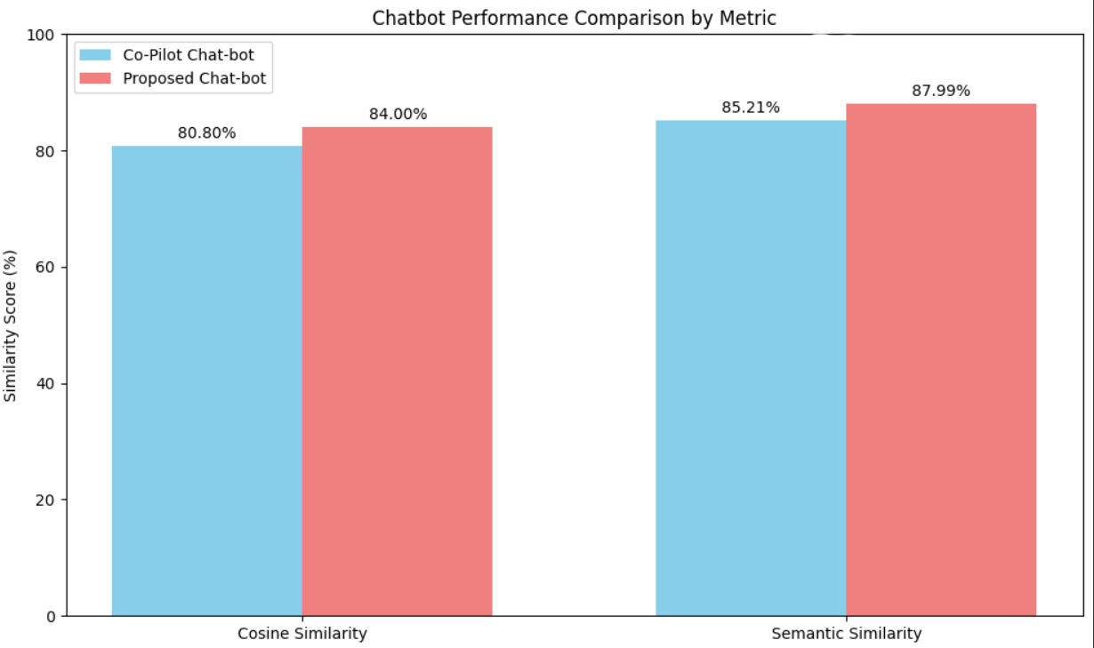
Quantitative Comparison:
The Proposed Chat-bot outperformed the Co-Pilot Chat-bot in both metrics.
Improvement of ~3.2% in Cosine Similarity and ~2.8% in Semantic Similarity.
Indicates better contextual understanding and response accuracy in the proposed model.
The enhanced model demonstrates higher alignment and semantic coherence with user inputs, proving its effectiveness over the baseline Co-Pilot Chat-bot.

Slide 30

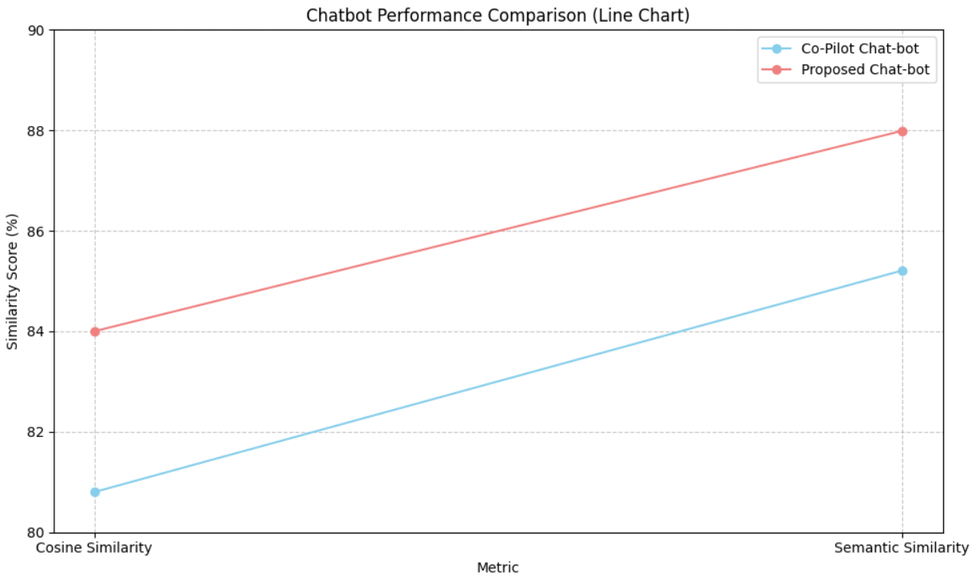
The Proposed Chat-bot consistently performs better in both metrics.
Improvement trend indicates enhanced context comprehension and semantic accuracy.
Performance gap between the two models widens slightly as semantic understanding increases.
The line chart demonstrates that the Proposed Chat-bot delivers superior similarity scores across both metrics, validating its improved NLP and response relevance capabilities over the baseline Co-Pilot Chat-bot.

Slide 31
Results and Discussion:
The proposed PDF chatbot achieved high semantic accuracy with an average cosine similarity of 0.85.
Top-3 retrieval accuracy exceeded 90%, confirming strong contextual matching.
Compared to the Co-Pilot chatbot, it showed higher semantic similarity (87.99% vs. 85.21%) and lower response time (3–5 sec/query).
Generated answers were fluent, coherent, and contextually relevant, reducing hallucinations and irrelevant outputs.
Results indicate that combining semantic retrieval (FAISS + Sentence-BERT) with generative modeling (FLAN-T5) provides balanced performance in both accuracy and efficiency.

Slide 32
Applications and Use Cases
Academic research paper querying and literature review
Student learning support for technical subjects
Project documentation and management assistance
Legal and policy document analysis
Corporate knowledge-base querying
Technical manuals and user documentation support
Enterprise-level document intelligence systems

Slide 33
Limitations of the Current System
Supports only text-based PDFs in the current version
Performance depends on document size and chunk configuration
Occasional hallucinations for highly ambiguous queries
No image, table, or diagram understanding yet
Requires GPU for optimal latency performance
Domain-specific fine-tuning not applied
Dependency on quality of extracted PDF text

Slide 34
CONCLUSION
Developed an interactive PDF-based chatbot that integrates Sentence-BERT for semantic embeddings, FAISS for efficient similarity-based retrieval, and FLAN-T5-XL for high-quality generative answer.
Achieved context-aware, accurate, and human-like responses by leveraging retrieval-augmented generation, without requiring any additional domain-specific fine-tuning of the language model.
Demonstrated superior performance over baseline models, achieving higher semantic similarity scores and reduced response latency through optimized vector indexing and GPU acceleration.
Validated the robustness of the system across multiple technical queries, showing consistent performance even when user questions were paraphrased or indirectly phrased.
Effectively minimized irrelevant responses and hallucinations by grounding generation strictly in retrieved document context.
Confirmed the scalability and modularity of the architecture, allowing easy replacement or enhancement of individual components such as embedding models or retrievers.

Slide 35
FUTURE SCOPE
Domain-Specific Fine-Tuning: Fine-tuning the system for specialized domains such as legal, medical, academic, and financial documents to improve terminology understanding, precision, and regulatory compliance.
OCR and Layout-Aware Parsing: Integration of advanced Optical Character Recognition (OCR) combined with layout-aware models to accurately process scanned PDFs, handwritten content, tables, figures, and multi-column layouts.
Multimodal Document Understanding: Extension toward vision-language models to interpret images, charts, diagrams, and infographics embedded within documents.
Cloud and API-Based Deployment: Deployment as a cloud-hosted service or RESTful API to support enterprise-scale document repositories and multi-user environments.

Slide 36
REFERENCES
E. Adamopoulou and L. Moussiades, “An overview of chatbot technology,” in Artificial Intelligence Applications and Innovations, IFIP Advances in Information and Communication Technology, vol. 584, pp. 373–383, Springer, 2020. doi: 10.1007/978-3-030-49161-1 31.
B. A. Shawar and E. Atwell, “Chatbots: Are they really useful?,” LDV Forum, vol. 22, no. 1, pp. 29–49, 2007.
J. Devlin, M.-W. Chang, K. Lee, and K. Toutanova, “BERT: Pre-training of deep bidirectional transformers for language understanding,” in Proc. NAACL-HLT, 2019, pp. 4171–4186. doi: 10.18653/v1/N19-1423.
Adobe Systems, “PDF reference, sixth edition,” 2006. [Online]. Available: https://www.adobe.com/devnet/pdf/pdf reference.html. [Accessed: Jul. 13, 2025].
J. Guo, Y. Fan, Q. Ai, and W. B. Croft, “A deep relevance matching model for ad-hoc retrieval,” in Proc. ACM Int. Conf. Information and Knowledge Management (CIKM), 2016, pp. 55–64. doi: 10.1145/2983323.2983769.

Slide 37

Vaswani et al., “Attention is all you need,” in Advances in Neural Information Processing Systems (NeurIPS), 2017, pp. 5998–6008.
N. Reimers and I. Gurevych, “Sentence-BERT: Sentence embeddings using Siamese BERT-networks,” in Proc. EMNLP, 2019, pp. 3982–3992. doi: 10.18653/v1/D19-1410.
J. Johnson, M. Douze, and H. Jegou, “Billion-scale similarity search ´ with GPUs,” IEEE Trans. Big Data, vol. 7, no. 3, pp. 535–547, 2021. doi: 10.1109/TBDATA.2019.2921572.
H. W. Chung et al., “Scaling instruction-finetuned language models,” arXiv preprint arXiv:2210.11416, 2022.
J. Weizenbaum, “ELIZA — a computer program for the study of natural language communication between man and machine,” Commun. ACM, vol. 9, no. 1, pp. 36–45, 1966. doi: 10.1145/365153.365168.

Slide 38
Y. Zhang et al., “Dialogpt: Large-scale generative pre-training for conversational response generation,” in Proc. ACL System Demonstrations, 2020, pp. 270–278.
S. Robertson and H. Zaragoza, “The probabilistic relevance framework: BM25 and beyond,” Found. Trends Inf. Retr., vol. 3, no. 4, pp. 333–389, 2009. doi: 10.1561/1500000019.
T. Neumann, A. Becker, and M. Hofmann, “Design and evaluation of an LLM-powered chatbot for database education,” in Proc. ACM Conf. Learning at Scale, 2025.
K. Alam, M. M. Rahman, and T. Akter, “A PDF-driven AI chatbot for project document management,” Int. J. Adv. Comput. Sci. Appl., vol. 15, no. 1, pp. 1–10, 2025.
W. Wu and J. Luo, “Challenges of AI chatbot adoption for SMEs: A resource allocation perspective,” J. Small Bus. Manage., vol. 63, no. 2, pp. 234–249, 2025.

Slide 39

ACKNOWLEGEMENTS
We sincerely thank our guide SYED RIZWANA MADAM for their valuable guidance, encouragement, and continuous support throughout the project.
We would like to thank the Head of the Department and faculty of Computer Science and Engineering, Narasaraopeta Engineering College, for providing essential resources and technical support.
We extend our gratitude to the Department of Computer Science and Engineering, Narasaraopeta Engineering College, for providing the required infrastructure and opportunity to present this work.
For any queries or further information, please reach out to:satishduddu29@gmail.com

Slide 40
QUESTIONS and ANSWERS

